Slide 1
OPAM Exercise

Slide 2
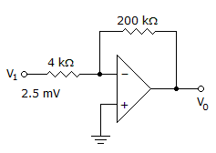
Vo = -0.125mV

Slide 3
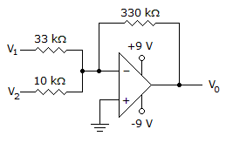
Calculate the output voltage if V₁ = V₂ = 0.15 V
–6.45 V

Slide 4
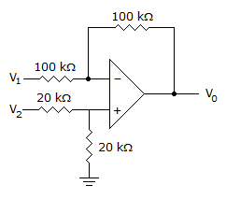
Determine the output voltage when V₁ = V₂ = 1 V

Slide 5
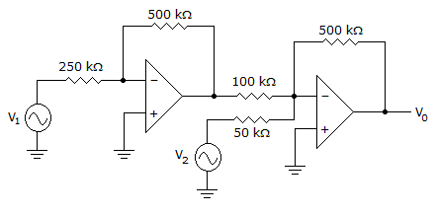
V1 = V2 = 700mV

Slide 6
V1 = 300mV, V2 = 700mV
-4V

Slide 7
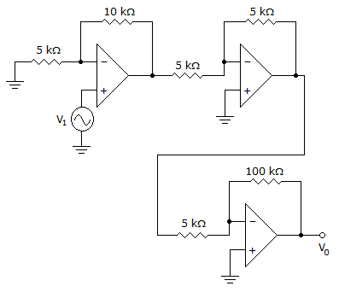
Calculate the input if the output is 10.08V
0.168V

